Slide 1
It Takes a Team! Ideas to Develop a School Culture and Program to Support All Students
Dr. Karen Tesik, Dr. Chad Corey, Mr. Michael Ryan,
Ms. Christa Ann Loughran-Mellozzo, Ms. Debra Dituri
South Orangetown Middle School
Blauvelt, NY
blogs.socsd.org/soms

Slide 2
RTI, CST, & SST Student-Centered Structures
RTI
CST
SST

Slide 3
Discussion vs. Dialogue
Dr. Peter Senge makes a powerful distinction between dialogue and discussion
In a discussion, opposing views are presented and defended and the team searches for the best view to help make a team decision. In a discussion, people want their own views to be accepted by the group. The emphasis is on winning rather than on learning.
In dialogue, people freely and creatively explore issues, listen deeply to each other and suspend their own views in search of the truth. People in dialogue have access to a larger pool of knowledge than any one person enjoys. The primary purpose is to enlarge ideas, not to diminish them. It’s not about winning acceptance of a viewpoint, but exploring every option and agreeing to do what is right.

Slide 4
Response to Intervention Team (RTI)
The goal of RTI is not to delay or postpone student access to needed special education services, but it is to broaden the ranges of academic and behavioral interventions in the general education setting.
The RTI team is comprised of:
School Psychologists
Guidance Counselors
Administration
General Education Teachers
Speech & Language Pathologists
Other Professionals as needed

Slide 5
Response to Intervention (RTI) and the
Individuals with Disabilities Education Act
“The reports of both the House and the Senate Committees accompanying the IDEA reauthorization bills reflect the Committees concerns with models of identification of specific learning disabilities that use IQ tests, and other recognition that a growing body of scientific research supports methods, such as RTI, that more accurately distinguishes between children who truly have specific learning disabilities from those whose learning difficulties could be resolved more specifically based, general education interventions” U.S. Department of Education 2007.

Slide 6
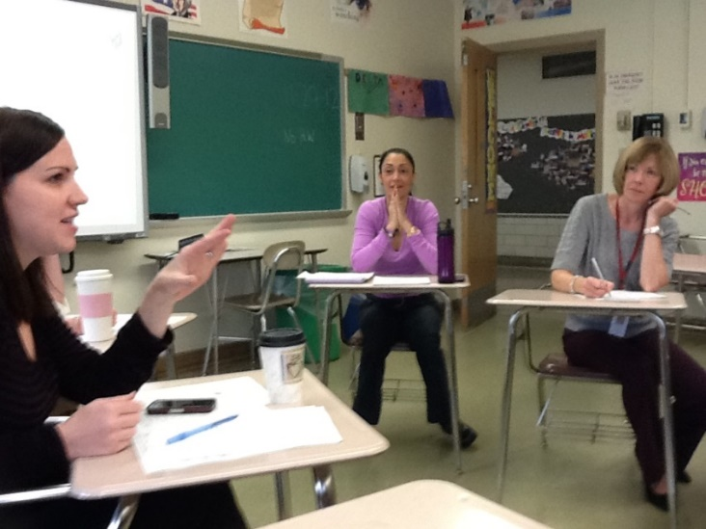
RTI & South Orangetown Middle School
Our district supports an interdisciplinary team model. These teams, made up of adults that teach different subjects, but the same students, who meet at a regular common planning time to plan ways to integrate the curriculum, analyze test data, review student work, discuss current research, and reflect on the effectiveness of instructional approaches.
When a student is struggling with either academics or behavioral issues the grade level team begins the process to recommend a student for RTI services.

Slide 7
Steps in RTI Process at SOMS
1. Prior to any referral the team of teachers does a “first look” at the student and evaluates the student’s areas of strengths and weaknesses. At this meeting teachers discuss informal ways to address their concerns.
2. If there is no improvement from the informal interventions, the team of teachers fills out a referral form and attaches work samples.
3. At the RTI initial meeting a work protocol or behavior protocol is done. SOMS specifically uses the Tuning Protocol. The objective of this protocol is to determine which activities will get our students to meet specific goals. This protocol helps the learning team assess and analyze whether their lessons are aligned with their goals.
4. Parents are contacted and notified that their child is being referred to RTI. Any recommendations or strategies made by the team are shared with the parent.

Slide 8
Steps in the RTI Process at SOMS
5. After the protocol recommendations are made and Tier I strategies are created to support the student. Dates and protocols on how to collect data are set up. Data is collected and shared with the team, the Child Study Team (CST) and with the parents.
6. If a student does not respond to the Tier I interventions, other Tier I interventions can be tried or Tier II interventions can be implemented.
7. If the child continues to show no improvement, the Tier III interventions maybe considered and applied.
8. If no progress or improvement is made the child is referred to the Child Study Team (CST).

Slide 9
Response to Intervention (RTI)
It is a three tier approach to provide support and interventions through quality instruction to meet the needs of students. Data needs to collected, monitored, and then analyzed regarding the student’s progress. The data provides key insights to how and what instructional changes need to be made.

Slide 10
3 Tiers to Response to Intervention
Tier I: Interventions are common and can be offered to all students. These strategies are researched based and allow for the child to reach success in the classroom.
Examples:
Differentiated Instruction
Best Practices
Progress Monitoring
Parental Involvement
Standards Based Math Program (ALEX)
Social Emotional Assistance (Guidance/Social Worker)

Slide 11
3 Tiers to Response to Intervention
Tier II: If a student does not make adequate progress with Tier I strategies, more intensive services and interventions may be needed.
Examples:
Supplemental support (Wilson Reading)
Use of technology to facilitate learning
Learning Styles
Multiple Intelligence Theory
Homework Help
Enhancements
STAR

Slide 12
3 Tiers to Response to Intervention
Tier III: For students who do not adequately respond to the targeted interventions in Tier II, there are additional services we can provide.
Examples:
More time in Enhancements
Learning Center with the RTI Team
RTI Push-In
After School Institutes
Counseling with 1:1 School Psychologist
If the interventions are not successful, he/she is referred to the Child Study Team. The CST can make further recommendations to the RTI team or look to pursue services through Special Education.

Slide 13
Child Study Team (CST)
The goal of the CST is to determine whether or not a child is eligible for Special Education Services or to evaluate current placement and programs of all currently classified students.
The CST is comprised of:
School Psychologists
Guidance Counselors
Administration
Special Education Teachers
Speech & Language Pathologists
Other Professionals as needed

Slide 14
CST Process
Student is referred to the CST:
An RTI Student is referred by the RTI Committee
A Special Ed Student is referred by their case manager
A parent requesting initial testing for their child to receive services (504/IEP)

Slide 15
CST Meeting Protocol
Summary of the Case by Presenting teacher
Clarifying questions
“Digging in” Discussion
Reflection
Team Brainstorm
Making a Plan
Debriefing
Follow Up Meeting
Data Review

Slide 16
All Kinds of Minds (AKOM) RTI Team Meeting Road Map RTI Teacher Referral Form RTI Direct Child Study Team Minutes
RTI and CST Tools for Effective Meetings

Slide 17
School Support Team (SST)
The goal of the SST is to determine whether or not a child needs additional social and emotional supports in order to be successful at the Middle School.
The SST is comprised of:
School Psychologists
Guidance Counselors
Administration
Other professionals as needed

Slide 18
SST Meeting Process
Every meeting begins with the SST engaging in a connections protocol.
All team members “post” student names for discussion.
Each member leads a debriefing about the student they posted.
Team members brainstorm additional supports if necessary or assign case manager to student

Slide 19
SST Resources
School Resource Officer (SRO)
Social Worker
Child Protection Services (CPS)
Probation Officers (PINS)
Community Resource Centers (CANDLE/IDT)
Professional Development & Education (LGTBQ)
Outside therapists
Local authorities
Department of Social Resources
Department of Mental Health
Local Hospitals
Nathan Klein Research Center

Slide 20
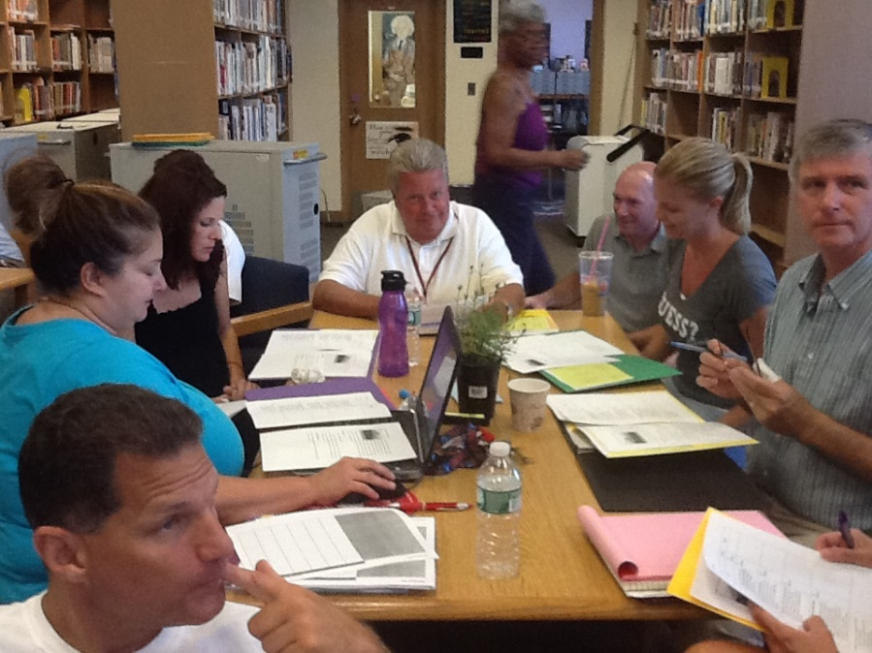
Effective meetings are not only integral to achieve team goals and successful completion of tasks, but also are reflective overall of team functioning. (Heinemann & Zeiss, 2002)

Slide 21
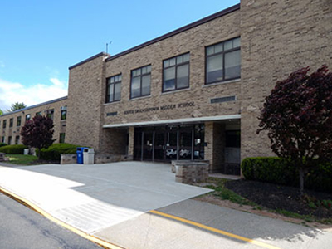
Presenters: Dr. Karen Tesik Dr. Chad Corey Mr. Michael Ryan Ms. Christa Ann Loughran-Mellozzo Ms. Debra Dituri
South Orangetown Middle School
Blauvelt, NY
blogs.socsd.org/soms

