Slide 1
WELCOME
to
Kindergarten
September 10, 2019

Slide 2
Guiding Principles of our Teaching and Curriculum
We let kids know what is expected of them and the very next steps toward improvement by using exemplars, rubrics and student checklists with students.
We emphasize the WHY, explain the WHAT and teach the HOW explicitly and clearly for every lesson.
We bring joy to all academic experiences.
We challenge students and support their individual needs.

Slide 3
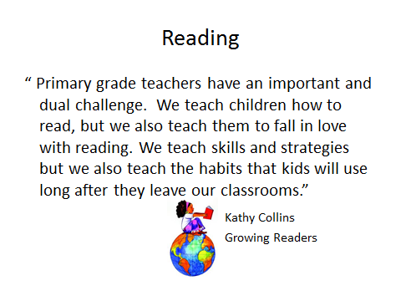

Slide 4
What does Reading Look Like in
Kindergarten?
Throughout the day children participate in a variety of different reading experiences.
Read Aloud- vocabulary, comprehension
Shared Reading- word work, fluency
Guided and Independent Reading- strategy instruction and practice
Phonics- Teachers College Phonics

Slide 6
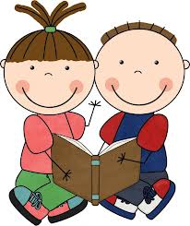
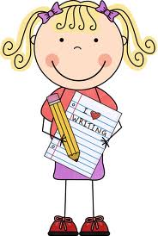
ELA Curriculum Units of Study
Reading | Writing
We Are Readers | Launching Writer’s Workshop
Emergent Reading: Looking Closely at Familiar Texts | Show and Tell
Super Powers: Reading with Print Strategies & Sight Word Power | Writing for Readers
Bigger Books, Bigger Reading Muscles | “How-To” Books-Writing to Teach Others
Growing Expertise in Little Books: Reading for Information | All About Books
Becoming Avid Readers | Crafting Stories Using All We know About Narrative Writing
Readers Get to Know Characters By Pretending & Performing Books | Persuasive Writing

Slide 7
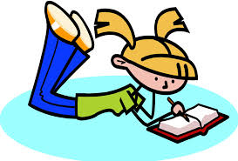

Slide 8
What drives our Math instruction?
A constructivist approach that puts students and inquiry at the center of learning.
Students engage in hands on, inquiry-based problem solving while learning the foundations of mathematics.
As in Reading and Writing, we use a workshop model.

Slide 9
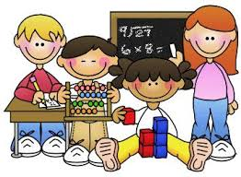
Mathematics
Units
Unit 1: Classroom Routines & Materials
Unit 2: Counting & Measurement 1
Unit 3: 2D Geometry
Unit 4: Counting and Measurement 2
Unit 5: 3D Geometry
Unit 6: Addition, Subtraction and the Number System 1
Unit 7: Modeling with Data
Unit 8: Addition, Subtraction and the Number System 2
At the end of trimester two we assess fluency with the following facts:
+1, +0, -1, -0 within 5.
At the end of trimester three we assess fluency with all addition and subtraction facts within 5.

Slide 10
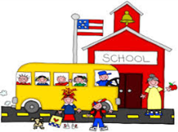
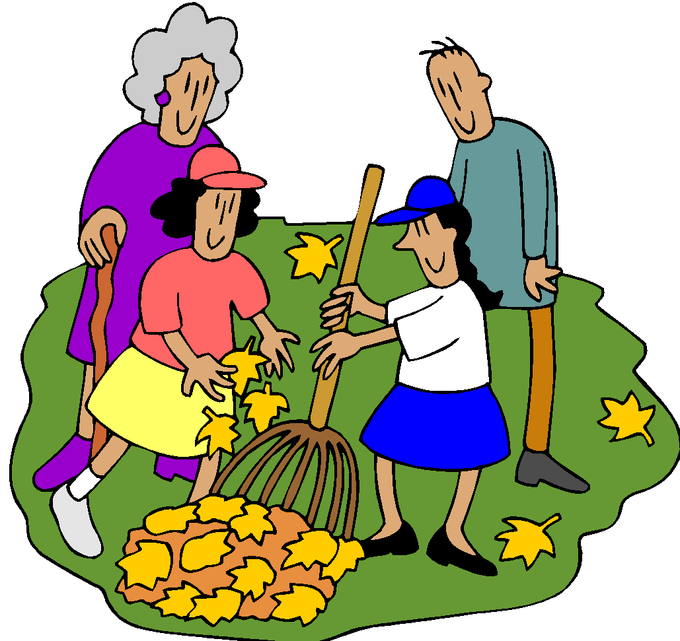
Social Studies
Unit | Description
School & School Community | What is a school? What does it mean to be a good school citizen? Why are rules important? What rules should we follow in our classroom/school?
Myself and Others | How are people alike and different? What is special about me
Families | Why are families important? How are families alike/different? What holidays do you celebrate in your family? What are some of your family traditions?
Community | What is a community? How do communities meet are needs? Who lives and works in a community?
Citizenship | What does it mean to be a good citizen? What are our responsibilities as a citizen of our country? What are some of the symbols that represent our country?
Notes:
Curriculum folder does not have matching units or fleshed out descriptions, though content and essnetial questions overlap
rules- civic ideals- holidays and traditions- identity- maps and globes- wants and needs

Slide 11
Science
Unit | Goals
What is a Scientist? What Tools do Scientists Use? | For students to understand how and why scientist do experiments and explore the world through their senses. Students will be introduced to some tools scientists may use in their studies.
Weather, Climate and Matter | For students to understand weather, weather patterns and how the movement of the Earth and Sun affect the changes in the seasons.. They will be able to describe the weather based on their senses and measurements taken by meteorologists. They will be able to use visual clues to predict the weather (ie grey clouds mean rain is coming). They will then use this information to build a sun and rain shelter for the Monster friends Molly and Matty.
Interdependent Relationships in Ecosystems: Animals, Plants and Their Environments | Students will study what plants and animals need to survive. Observe how plants and animals change their environments to meet their needs and how plants and animals interact in their habitat. Within the study they will learn how human decisions impact their environment and suggest ways that humans can reduce their impact on the living and nonliving environment around them. The garden can also be incorporated into this study
Force and Motion | Students will be able to describe pushes and pulls and experiment with how these change the movement of objects. They will test how the amount of force and direction of force change these movements and design their own experiments to explore these concepts.

Slide 12
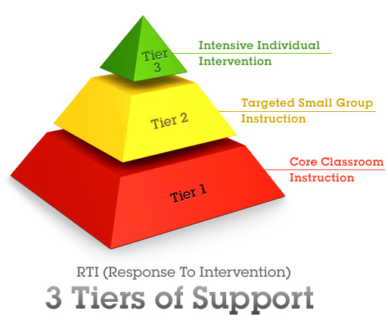
Response to Intervention (RTI)
…a research based approach to providing high quality individual or small group instruction to students who experience difficulty making progress in their grade level curriculum.

Slide 13
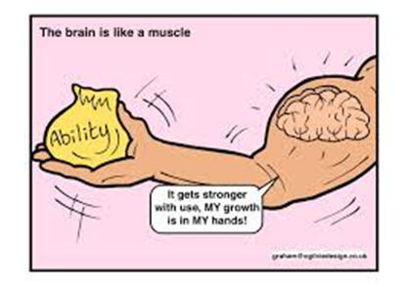
Growth Mindset
Mindsets are the assumptions and expectations we have for ourselves and others. They guide our behavior and influence our responses to daily events.
A growth mindset is the belief that we have the capacity to cultivate our intelligence and grow our abilities. Everything is malleable because the brain is like a muscle. It grows through effort, practice, and challenging exercise.
“When students and teachers focus on improvement rather than whether the children are smart, kids learn a lot more.”
~Lisa Blackwell Ph.D.

Slide 14
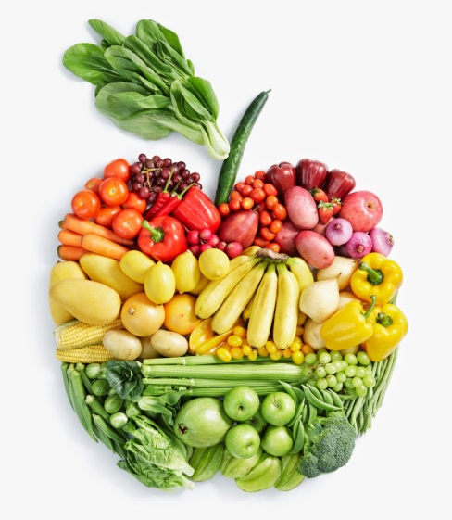
Snack
We have a snack in the morning.
We don’t have a lot of time for snack.
Please send in only one snack a day and some water/juice.
No glass bottles please.
Healthy snacks make the children have a better, more focused day.

Slide 15
Birthdays
We celebrate birthdays for any families who want to come in.
We do not do birthday snacks.
We have a family reader come in.
We can do a birthday craft, if you’d like.
We make birthday books!

Slide 16
Behavior
Behavior is very important in order for our students to learn and grow.
We use a behavior chart to monitor how our day is going.
Children have the opportunity to all start their day “Ready to Learn”.
According to their behavior, they can move up or down the chart.
If they move up, they are working hard and listening.
If they move down, they are in need of reminders or refocusing.
Children always have the opportunity to improve their day.
Notes:
? do all do this?

Slide 17
How Can You Help Strengthen the Home/School Connection?
Establishing high expectations- Let your child know you believe in his ability to meet challenges. Focus on the actions that can be taken to improve.
Creating a risk free learning zone- Make it clear mistakes are to be expected and we can learn from them.
Giving feedback that focuses on process- Discuss the things your child can control, like his effort, challenge-seeking, persistence, and good strategies--not on his/her personal traits or abilities. Avoid praising children for their "smartness," and instead help them understand the importance of their own actions in achieving success.
Providing frequent reminders to your child that the mind is malleable- Let your child know that when he is practicing hard things his brain is forming new connections. Instead of feeling dumb when he struggles, he will learn to "feel" those connections growing.
If parents want to give their children a gift, the best thing they can do is to teach their children to love challenges, be intrigued by mistakes, enjoy effort, and keep on learning. That way, their children don’t have to be slaves of praise. They will have a lifelong way to build and repair their own confidence.
~Carol Dweck (Psychologist)

